Slide 1
Scheme

Slide 2
History
Lisp (List Processing Language) is one of the oldest programming languages still in wide use. It was developed in the late 50s and early 60s by John McCarthy.
Innovations include:
Support of symbolic computations.
A functional programming style without emphasis on assignments and side-effects.
A naturally recursive programming style.
Dynamic (run-time) type checking.
Dynamic data structures (lists, binary trees) that grow without limit.
Automatic garbage collection to manage memory.
Functions are treated as “first class” values; they may be passed as arguments, returned as result values, stored in data structures, and created during execution.
A formal semantics (written in Lisp) that defines the meaning of all valid programs.
An Integrated Programming Environment to create, edit and test Lisp programs.

Slide 3
Scheme
Scheme is a recent dialect of Lisp.
Uses lexical (static) scoping.
Supports true first-class functions.
Provides program-level access to control flow via continuation functions.

Slide 4

Scheme: A First Example
Recursive computation of Fibonacci sequence values:
Defining function fib with one input argument: n
(define (fib n)
(if (< n 2)
n
(+ (fib (- n 1)) (fib (- n 2)))
)
)
Operators use prefix notation.
Begin / end of an expression.
=> means "evaluates to"
Scheme control structures are expressions thus () surround all expressions.
A call to fib:
(fib 10)
Exercise 1

Slide 5
Scheme Fundamentals: Atomic Types
Atom | Descriptor | Example
Symbols | Essentially any sequence of printable characters is allowed; anything that starts a valid number (except + or -) may not start a symbol. | abc hello-world + <=!
Integers | Any sequence of digits, optionally prefixed with a + or -. Usually unlimited in length. | 1 +1 -999999999999999
Reals | A floating point number in a decimal format or in exponential format. A leading sign and a signed exponent are allowed. | 123.456 1.23e45 -12.3, 10.0e-20
Character | A single character prefixed by #\. Two special characters are #\space and #\newline. | #\a, #\0, #\\, #\#
String | A sequence of characters. Double quotes and backslashes must be escaped using a backslash. | "Hello World" "\"Wow!\""
Boolean | True is represented as #t. False is represented as #f.

Slide 6
Scheme Fundamentals: Binary Trees
Binary trees are also called S-Expressions in Lisp and Scheme and are of the form:
( item1 . item2 )
where an item is any atomic value or any S-Expression.
S-Expressions are linearizations of binary trees.
(1.2 . "xyz")
( (A . B) . C )
( A . (B . C) )
C
A
1.2
"xyz"
A
B
B
C
Exercise 2-3

Slide 7




Predefined Functions: cons, car, and cdr
cons builds a new S-Expression from two S-Expressions that represent the left and right children.
car returns the left subtree of an S-Expression.
cdr returns the right subtree of an S-Expression.
(cons E1 E2) => (E1 . E2)
car (E1 . E2) => E1
cdr (E1 . E2) => E2
(define btree (cons (cons 1 2) (cons 3 4) ) )
(print btree)
The origins of the names for car and cdr come from the IBM 704:
car is an acronym from the phrase Contents of the Address part of the Register; and
cdr is an acronym from the phrase Contents of the Decrement part of the Register.
(car btree)
(cdr btree)
(caar btree)
(cadr btree)

Slide 8
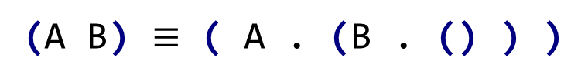
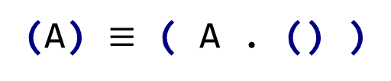

Lists
In Lisp and Scheme lists are a special, widely-used form of S-Expressions.
Empty or null list:
()
The list containing A:
(A)
Lists are S-expressions, so the list containing A is:
(A) $≡$ ( A . () )
( A B C ) $≡$
The list containing A and B:
(A B) $≡$ ( A . (B . () ) )
A
In general:
B
(A B C … Z) $≡$ (A . (B . (C . … (Z . ()) … )))
C
()

Slide 9


Function Calls
Function calls are represented as lists.
Is interpreted as the sequence:
Evaluate A (to a function)
Evaluate B and C (as parameters)
Call A with B and C as its parameters.
The value returned by the call is the “meaning” of (A B C).
(A B C)
cons, car, and cdr are predefined symbols bound to built-in functions that build and access lists and S-Expressions.

Slide 10





Building Lists
If lists are interpreted as function calls, how do we build a list of values?
Consider the expression:
(car (1 2))
We need a way to “quote” symbols and lists we do not want evaluated.
(quote arg)
is a special function that returns its argument unevaluated.
Since quotation is used so frequently, it may be abbreviated using a single quote.
(quote arg) $≡$ 'arg
(car '( a b c ) )
(cdr '(( A ) ( B ) ( C ) ) )
(cons 'a '1)
Exercise 4

Slide 11

Anonymous User-Defined Functions
Anonymous functions (those defined without a name) are often referred to as lambda functions (or lambda expressions).
(lambda (args) (body))
evaluates to a function with (args) as its argument list and (body) as the function body. No quotes are needed for the arguments or body.
What action does the following function perform?
(lambda (x) (+ x 1))
incrementing
((lambda (x) (+ x 1)) 10)
Called with an input of 10:
Exercise 5

Slide 12


Defining Globals
We can bind values and functions to global symbols using the define function.
(define id object)
where id is not evaluated but object is; id is bound to the value object evaluates to.
(define pi 3.1415926535)
(define plus1
(lambda (x) (+ x 1))
)
Once a symbol is defined, it evaluates to the value it is bound to:
(define pi*2 (* pi 2))

Slide 13

Defining Functions
Since functions are frequently defined, we abbreviate
(define id
(lambda (args) (body))
)
as
(define (id args) (body))
We might define plus1 as:
(define (plus1 x) (+ 1 x))
Exercise 6

Slide 14

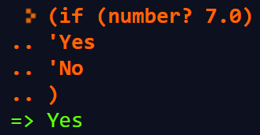
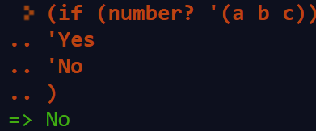
Conditional Expressions and if
A predicate is a function that returns a boolean value. By convention, in Scheme, predicate names end with '?'.
number? symbol? equal? null? list?
In conditionals, #f is false, and everything else, including #t, is true.
The if expression:
(if pred E1 E2)
(if (= 1 (+ 0 1))
'Yes
'No
)
First, pred is evaluated.
Depending on value of pred (#f or not), either E1 or E2 is evaluated (but not both) and returned as the value of the if expression.
Exercise 7

Slide 15

Generalized Conditional (Case Statement)
(cond
(p1 e1)
(p2 e2)
...
(else en)
)
Each predicate (p1, p2, ...) is evaluated until one is true (not #f).
The corresponding expression (e1, e2, ...) is evaluated and returned as the value of the cond.
(define a 10)
(cond
((= a 1) 2)
((= a 2) 3)
(else 4)
)
else acts like a predicate that is always true.

Slide 16


Recursion
Recursion is widely used in Scheme and most other functional programming languages.
Rather than using a loop to step through the elements of a list or array, recursion breaks a problem on a large data structure into a simpler problem on a smaller data structure.
For example, append function, which joins (or appends) two lists into one larger list containing all the elements of the two input lists (in the correct order).
(append '(a b) '(c d))
Compare to cons: adds one element to the head of an existing list.
(cons '(a b) '(c d))

Slide 17
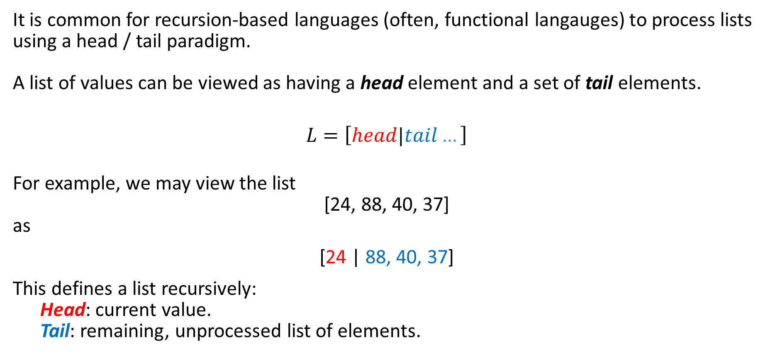
Recursive List Processing with Head / Tail
It is common for recursion-based languages (often, functional langauges) to process lists using a head / tail paradigm.
A list of values can be viewed as having a head element and a set of tail elements.
$$L=\left[head|tail…\right]$$
For example, we may view the list
[24, 88, 40, 37]
as
[24 | 88, 40, 37]
This defines a list recursively:
Head: current value.
Tail: remaining, unprocessed list of elements.
Exercise 8-9
Exercise 10-11

Slide 18
Recursive List Processing with Head / Tail
Exercise 12
(define (head List) (car List))
(define (tail List) (cdr List))
(define (int-list->string List)
(if (null? List)
""
(string-append (number->string (head List)) (int-list->string (tail List)))
)
)
process head
recursively process tail
(define (int-list->string L)
(if (null? L)
""
(string-append (number->string (car L)) (int-list->string (cdr L)))
)
)

Slide 19
Defining append
Exercise 13
Use cons to define an append function. Recall that append takes two lists as input and results in a new list.
(define (append L1 L2)
(if (null? L1)
L2
(cons (car L1)
(append (cdr L1) L2))
)
)
Base Case: Nothing in L1 to append; just return L2.
The first element of the new list is the 'head' of L1.
Recursively construct our list with the tail of L1 and all of L2.

Slide 20
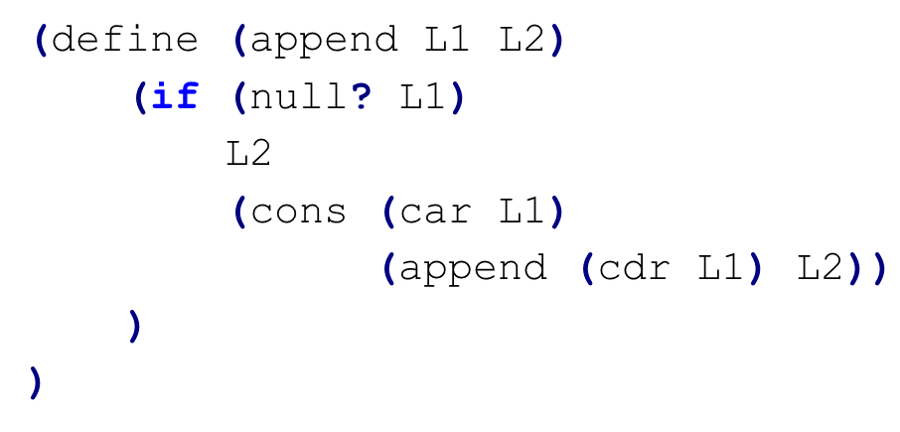
Tracing Append
(append '(a b) '(c d))
L1
L2
(cons (car L1) (append (cdr L1) L2))
(car '( a b )) => 'a
(cdr '( a b )) => '( b )
(cons 'a '(b c d))
=> '(a b c d)
(append '( b ) L2))
(cons 'b '(c d))
=> '(b c d)
(car '( b )) => 'b
(cons 'b (append ( ) L2))
L2

Slide 21

Reversing a List
Another useful list-manipulation function is rev, which reverses the members of a list. That is, the last element becomes the first element, the next-to-last element becomes the second element, etc.
Exercise 14
(define (rev L)
(if (null? L)
L
(append (rev (cdr L)) (list (car L)))
)
)
Exercise 15
Make a singleton list of the head of L.
Reverse the tail of L.

Slide 22


Deep Reversal
As constructed, rev only reverses the “top level” elements of a list. That is, members of a list that themselves are lists are not reversed.
We can generalize rev to also reverse list members that happen to be lists.
To do this, it will be convenient to use Scheme’s let construct.

Slide 23
The let Construct
Most languages allow us to create local variables, etc. Scheme allows us to create local names, bound to values, for use in an expression using let. This is powerful in scheme since everything is an expression.
(let ( (id1 val1) (id2 val2) ... ) expr )
In this construct, val1 is evaluated and bound to id1, which will exist only within this let expression.
If id1 is already defined (as a global or parameter name) the existing definition is hidden and the local definition, bound to val1, is used. (This allows us to "locally redefine" operators and functions.)
val2 is evaluated and bound to id2 (which will exist only within this let expression).
Finally, expr is evaluated in a scope that includes id1, id2, ...

Slide 24


Simple let Examples
Defining local variables:
(let ( (a 10) (b 20) ) (+ a b))
(let ( (lh '(a b)) (rh '(c d)) ) (append lh rh))
(let ( (lh '(a b)) (rh '(c d)) ) (cons lh rh))
Exercise 16

Slide 25

Deep Reversal
(define (rev L)
(if (null? L)
L
(append (rev (cdr L)) (list (car L)))
)
)
Shallow Reversal
Deep Reversal
(define (revall L)
(if (null? L)
L
)
)
let to manipulate the head of L.
(let ((E (if (list? (car L))
(revall (car L))
(car L) )
))
)
Is the head of L a list?
Reverse the head of L recursively.
'Normal' head of L.
(append (revall (cdr L)) (list E))
(revall '(a b (c d) e (() 4))

Slide 26
Powerset
Given a set of (unique) items (atoms), we sometimes wish to compute the set of all possible subsets. We refer to the set of all possible subsets as the powerset.
(powerset '(1 2 3))
=>
( () (1) (2) (3) (1 2) (1 3) (2 3) (1 2 3))
Although the powerset listed above is ordered based on subset size, the order is unimportant.
To compute the powerset, we wish to leverage Scheme's recursive processing. But what is the resursive step?
Instead of recursive thinking, consider an inductive approach.
(powerset '(1))
=>
( () (1) )
(powerset '(1 2))
=>
( () (1) (2) (1 2) )
Exercise 17

Slide 27
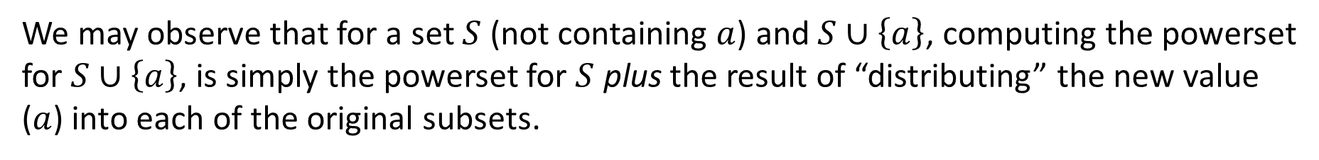
Powerset (continued)
Consider again inductive construction of some powersets.
(powerset '(1))
=>
( () (1) )
(powerset '(1 2))
=>
( () (1) (2) (1 2) )
(powerset '(1 2 3))
=>
( () (1) (2) (1 2) (3) (1 3) (2 3) (1 2 3) )
(powerset '(1 2))
Distributing 3 across
(powerset '(1 2))
We may observe that for a set $S$ (not containing $a$) and $S∪\left\{a\right\}$, computing the powerset for $S∪\left\{a\right\}$, is simply the powerset for $S$ plus the result of “distributing” the new value ($a$) into each of the original subsets.

Slide 28

Powersets: distrib
Exercise 18
Goal:
(distrib '(() (1) (2) (1 2)) 3)
=>
( (3) (3 1) (3 2) (3 1 2) )
(define (distrib L e)
(if (null? L)
()
(cons (cons e (car L))
(distrib (cdr L) e)
)
)
)
Distribute element e over a list of lists L.
Add e to the head of L.
Distribute e to the tail of L.
(distrib '( () (1) (2) (3) ) 4)

Slide 29
Powerset: extend
We should implement a method that collects the original list with an extension of that list:
(extend '( () (a) ) 'b)
=>
( () (a) (b) (b a))
original
Distributed extension
(define (extend L E)
(append L
(distrib L E)
)
)

Slide 30
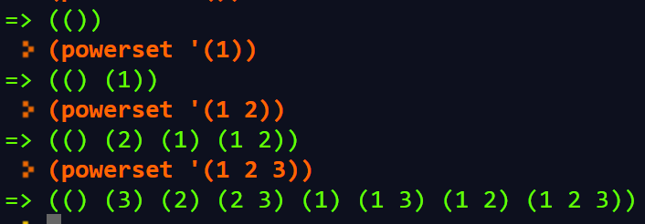
powerset
(define (distrib L E)
(if (null? L)
()
(cons (cons E (car L))
(distrib (cdr L) E)
)
)
)
(define (extend L E)
(append L
(distrib L E)
)
)
(define (powerset L)
(if (null? L)
(list ())
(extend (powerset (cdr L)) (car L))
)
)
powerset is always a list of lists.
Compute powerset of tail
extend head of L over the recursively constructed powerset.
(powerset '())
(powerset '(1))
(powerset '(1 2))
(powerset '(1 2 3))

Slide 31


Data Structures in Scheme: List Access
In Scheme, lists and S-expressions are basic. Arrays can be simulated using lists, but access to elements “deep” in the list can be slow (since a list is a linked structure).
To access an element deep within a list we can use a predefined function list-tail:
(list-tail L k)
This returns list L after removing the first k elements.
list-ref returns the k-th element in L (indexing from 0):
(list-ref L k)

Slide 32


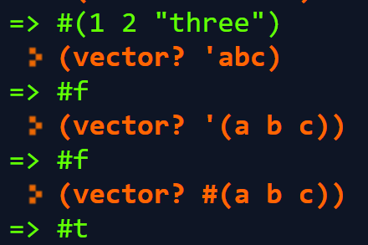

Vectors
Vectors are heterogenous structures whose elements are indexed by exact non-negative integers. A vector typically occupies less space than a list of the same length, and the average time required to access a randomly chosen element is typically less for the vector than for the list.
Think of a vector as one-dimensional array.
Vectors are of the form
#( ... )
This function tests whether val is a vector or not.
(vector? val)
The function evaluates v1, v2, ... and puts them into a vector.
(vector v1 v2 ... )

Slide 33


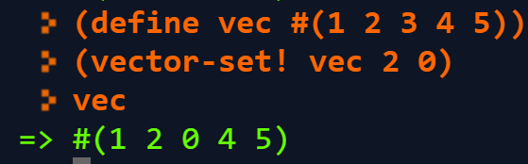
Vectors (cont.)
The function make-vector creates a vector composed of k copies of val.
(make-vector k val)
The function vector-ref returns the k-th element of vect, starting at position 0. It is essentially the same as vect[k] in C or Java.
(vector-ref vect k)
The function vector-set! sets the k-th element of vect, starting at index 0, to be val. It is essentially the same as vect[k] = val in C or Java.
The value returned by the function is unspecified. The suffix “!” in set! indicates that the function has a side-effect.
(vector-set! vect k val)

Slide 34
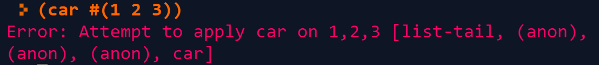


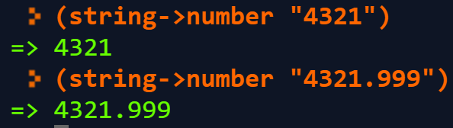
Vectors (cont.)
Vectors are not lists and lists are not vectors.
Thus, (car #(1 2 3)) does not work.
There are conversion routines:
vector->list converts vector V to a list containing the same values as V.
(vector->list V)
list->vector converts list L to a vector containing the same values as L.
(list->vector L)
In general Scheme names a conversion function from type T to type Q as T->Q.

Slide 35
Records and Structs
In Scheme we can represent a record, struct, or class object as an association list of the form
((obj1 val1) (obj2 val2) ...)
In the association list, which is a list of (object value) sublists, object serves as a “key” to locate the desired sublist.
The association list
( (A 10) (B 20) (C 30) )
struct {
int a = 10;
int b = 20;
int c = 30;
}
serves the same role as

Slide 36
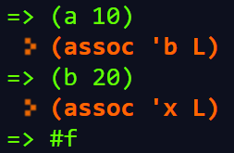
'Dictionary': assoc
The predefined assoc function
(assoc obj alist)
checks alist (an association list) to see if it contains a sublist with obj as its head.
If it does, the list starting with obj is returned; otherwise #f (indicating failure) is returned.
(define L '( (a 10) (b 20) (c 30) ) )
(assoc 'a L)
=>
(assoc 'b L)
=>
(assoc 'x L)
=>

Slide 37

'Dictionary': getValue
If an association list acts similarly to a dictionary (<key, value> mapping), we can write a
function (getValue) to return the value given a key.
(define (getValue key alist)
(if (assoc key alist)
(car (cdr (assoc key alist)))
#f
)
)
Is key in aList?
assoc returns a list with a pair;
cdr returns a list with second element;
car returns value associated with key.
(define L '( (a 10) (b 20) (c 30) ) )
Two forms of improvement:
The same call to assoc is made twice; we can save the value computed by using a let expression.
We can combine car and cdr are needed to extract a value.
(getValue 'a L)
=>
(getValue 'b L)
=>
(getValue 'x L)
=>

Slide 38
Improved 'Dictionary': getValue
Scheme has a number of predefined functions that combine several calls to car and cdr into one function. For example,
(define (getValue key alist)
(let ((pair (assoc key alist)))
(if pair
(cadr pair)
#f
)
)
)
(caar x) ≡ (car (car x))
(cadr x) ≡ (car (cdr x))
(cdar x) ≡ (cdr (car x))
(cddr x) ≡ (cdr (cdr x))
What does assoc do if more than one sublist with the same key exists?
It returns the first sublist with a matching key.
Exercise 20
Exercise 19

Slide 39
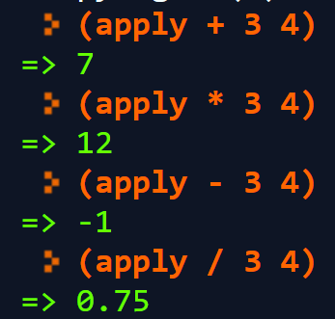

Functions are First-Class Objects
Functions may be passed as parameters, returned as the value of a function call, stored in data objects, etc.
This is a consequence of the fact that
(lambda (args) (body))
evaluates to a function just as
(+ 1 1)
evaluates to an integer.
Exercise 21
(define (apply func input1 input2)
(func input1 input2)
)

Slide 40


Scoping
In Scheme scoping is static (lexical). This means that nonlocal identifiers are bound to containing lambda parameters, or let values, or globally defined values.
(define (f x) (lambda (y) (+ x y)) )
Function f takes one parameter, x.
It returns:
a function (of y), with x in the returned function bound to the value of x used when f was called.
(f 10) ≡ (lambda (y) (+ 10 y))
Hence, if we wish to leverage the function that is being returned by (f 10) requires that we call this method AND provide an another value (that will be added to the bound x).

Slide 41

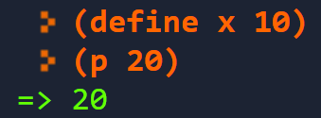
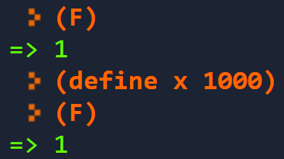
Scoping II
Unbound symbols are assumed to be globals; there is a run-time error if an unbound global is referenced.
(define (p y) + x y)
So, define x.
We can use let bindings to create private local variables for functions:
F is a function (requiring no arguments).
(define F
(let ( (x 1) )
(lambda () x)
)
)

Slide 42
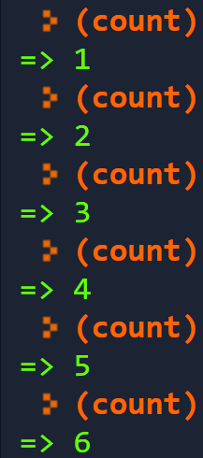
Scoping III
We can encapsulate internal state with a function by using private, let-bound variables:
(define count
(let ( (I 0) )
(lambda ()
(set! I (+ I 1)) I)
)
)
Initialize I to 0 (first time).
Persistent increment of variable I.

Slide 43
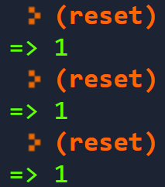
Scoping IV: Subtlety of let
We must check to determine if the let-bound value is created when the function is created or when it is called.
(define count
(let ( (I 0) )
(lambda ()
(set! I (+ I 1)) I)
)
)
(define reset
(lambda ()
(let ( (I 0) )
(set! I (+ I 1)) I)
)
)

Slide 44







Simulating Class Objects
Using association lists and private bound values, we can encapsulate data and functions. This gives us the effect of class objects.
Recall, mathematically, we can represent points in the Cartesian Plane as well as in Polar coordinates using the following right triangle in standard position.
(define (point x y)
(list
(list 'rect
(lambda () (list x y)))
(list 'polar
(lambda ()
(list
(sqrt (+ (* x x) (* y y)))
(atan (/ x y))
) ) ) ) )
Rectangular →Polar
$$\left(r,θ\right)$$
$$\left(x,y\right)$$
$$x^{2}+y^{2}=r^{2}$$
r
$$\tan{θ}=\frac{y}{x}$$
y
$$Θ$$
x
Polar → Rectangular
$$x=r\cos{θ}$$
$$y=r\sin{θ}$$

Slide 45

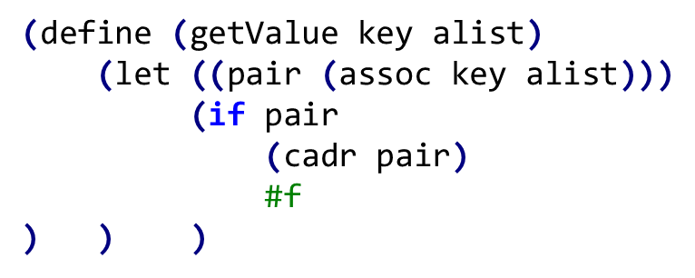
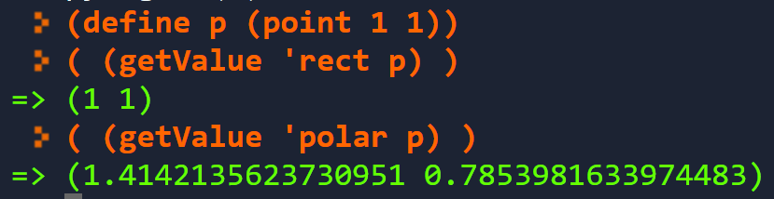


Simulating Class Objects II
The call (point 1 1) creates an association list of the form ( (rect funct) (polar funct) )
We can the use getValue to access components of the point:
$$\sqrt{2}$$
$$\frac{π}{4}$$

Slide 46
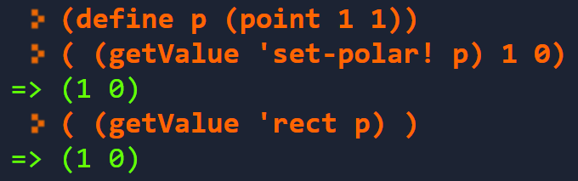
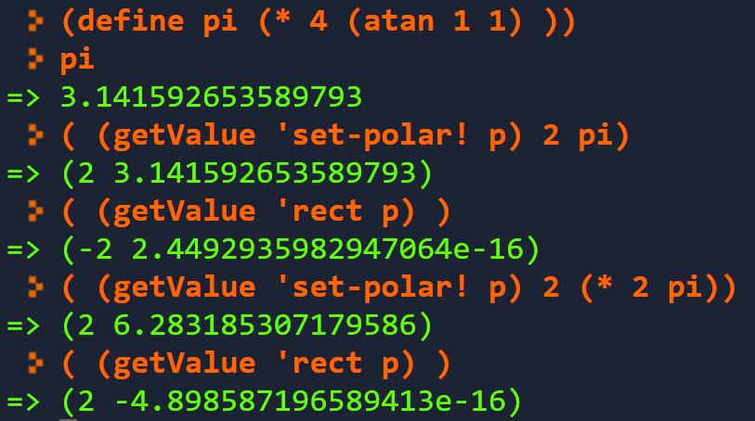


Simulating Class Objects III
We can add new functionality by just adding new (id function) pairs to the association list.
(define (point x y)
(list
(list 'rect (lambda () (list x y)))
(list 'polar
(lambda ()
(list
(sqrt (+ (* x x) (* y y)))
(atan (/ x y)) )))
(list 'set-rect!
(lambda (newx newy)
(set! x newx)
(set! y newy)
(list x y) ))
(list 'set-polar!
(lambda (r theta)
(set! x (* r (cos theta)))
(set! y (* r (sin theta)))
(list r theta)
))
))
$$\left(−2,0\right)$$
$$\left(2,0\right)$$

Slide 47
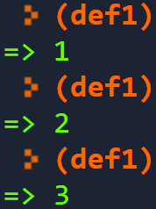
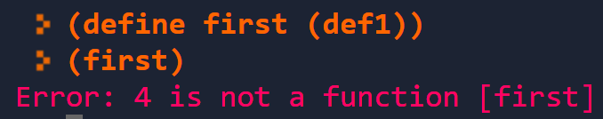

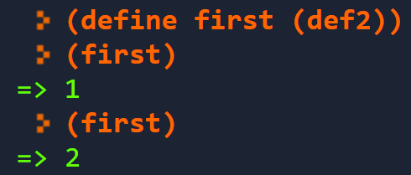
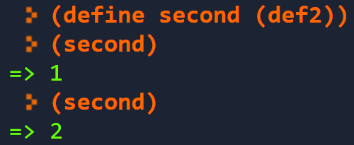
Limiting Access to Internal Structure
We can improve upon our association list approach by returning a single function (similar to a C++ or Java object) rather than an explicit list of (id function) pairs. We want the function to take the name of the desired operation as one of its arguments.
However, we need to consider the small difference between two definitions.
(define def1
(let ( (I 0) )
(lambda () (set! I (+ I 1)) I)
) )
(define (def2)
(let ( (I 0) )
(lambda () (set! I (+ I 1)) I)
) )
def1 is a zero argument function that increments a local variable and returns its updated value.
def2 is a a zero argument function that generates a function of zero arguments (that increments a local variable and returns its updated value). Each call to def2 creates a different function.

Slide 48
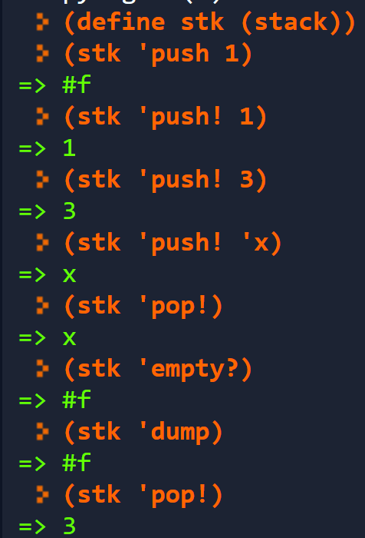
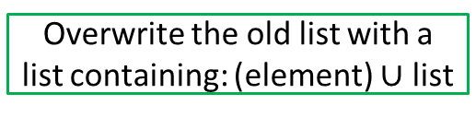
Stack (as a Function)
(define ( stack )
(let ( (s () ) )
(lambda (op . args) ; var # args
(cond
((equal? op 'push!)
(set! s (cons (car args) s))
(car s))
((equal? op 'pop!)
(if (null? s)
#f
(let ( (top (car s)) )
(set! s (cdr s))
top )))
((equal? op 'empty?) (null? s))
(else #f)
) ) ) )
Initialize the stack to be an empty list when the stack is created.
Input to stack: an S-expression consisting of an operation and any arguments it expects.
Overwrite the old list with a list containing: (element) $∪$ list
Return the top of the new list.
Empty stack: return false.
Save the head of the list
Set the stack to be the tail
Return the head
Unrecognized operation.
Exercise 22

Slide 49


Higher-Order Functions
A higher-order function is a function that takes a function as a parameter or one that returns a function as its result.
A very important (and useful) higher-order function is map, which applies a function to a list of values and produces a list or results:
(map (lambda (n) (+ 1 n)) '(1 2 3 4))
(define (mymap f L)
(if (null? L)
()
(cons (f (car L)) (mymap f (cdr L) ))
)
)
Exercise 23
map also works with multiple lists arguments:
In Scheme’s built-in implementation of map, the order of function application is unspecified.

Slide 50
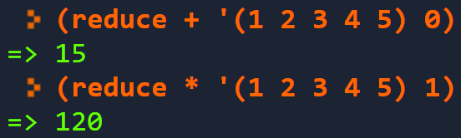
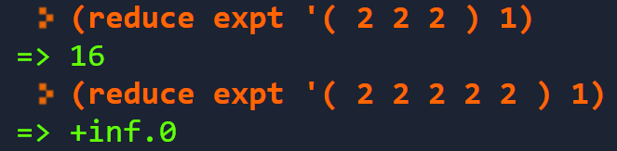

reduce
Another useful higher-order function is reduce, which reduces a list of values to a single value by repeatedly applying a binary function to the list values.
Input:
a binary function,
a list of data values,
and an identity value for the binary function.
Exercise 24
(define (reduce f L id)
(if (null? L)
id
(f (car L) (reduce f (cdr L) id))
) )

